Slide 1
Open Innovation – Climate Change
BlueberryCider

Slide 2
How Poverty and Trade Impact Carbon Footprint
This presentation will explore the impact of poverty and trade on carbon footprint
Impact of Poverty on Carbon Footprint
Poverty can contribute to higher carbon footprints due to lack of access to clean energy and inefficient use of resources.
Impact of Trade on Carbon Footprint
Trade can lead to increased carbon footprints due to transportation and production processes.

Slide 3
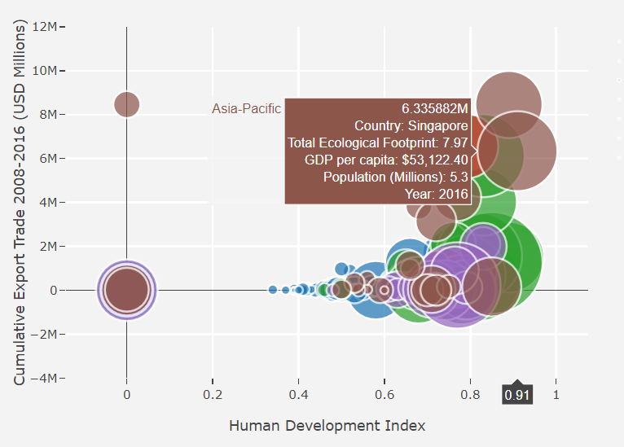
Analysis
Visualizing the relationship between Human Development Index (HDI), Cumulative Export Trade, and Carbon Footprint for different regions where each color represents a country .

Slide 4
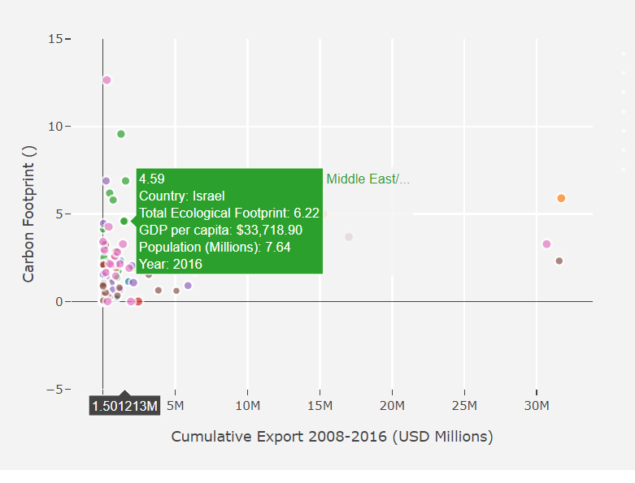
More a country trades, the more carbon footprint
Bubble chart that visualizes the relationship between Cumulative Export Trade and Carbon Footprint for different regions.

Slide 5
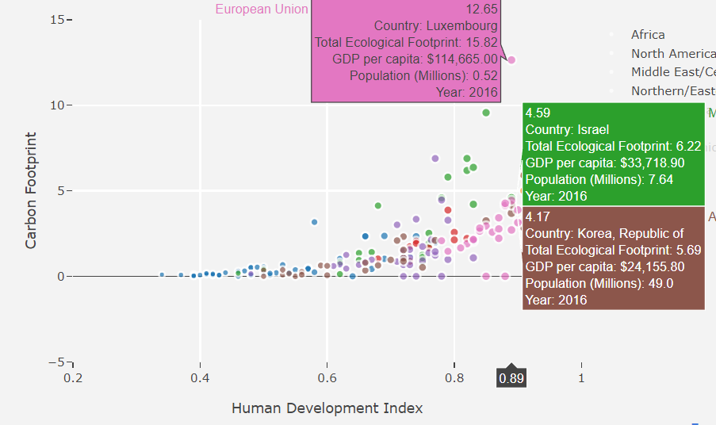
More Poverty a country has, the more carbon footprint

Slide 6
CO2 EMISSION IN SECTORS
CO2 emissions, primarily from the energy sector, transportation, and industry, are a major driver of global climate change. These emissions result from burning fossil fuels, industrial processes, and land-use changes. Mitigating CO2 emissions is crucial to combatting climate change, with efforts focused on renewable energy adoption, efficiency improvements, and sustainable practices.
Now that we have seen the relationship between the carbon footprint and that of poverty and trade. We will now measure the carbon footprint of every sector, that being Industry, Ground Transport , Domestic Aviation , International Aviation and etc for every major country that contributes to the emission.

Slide 7
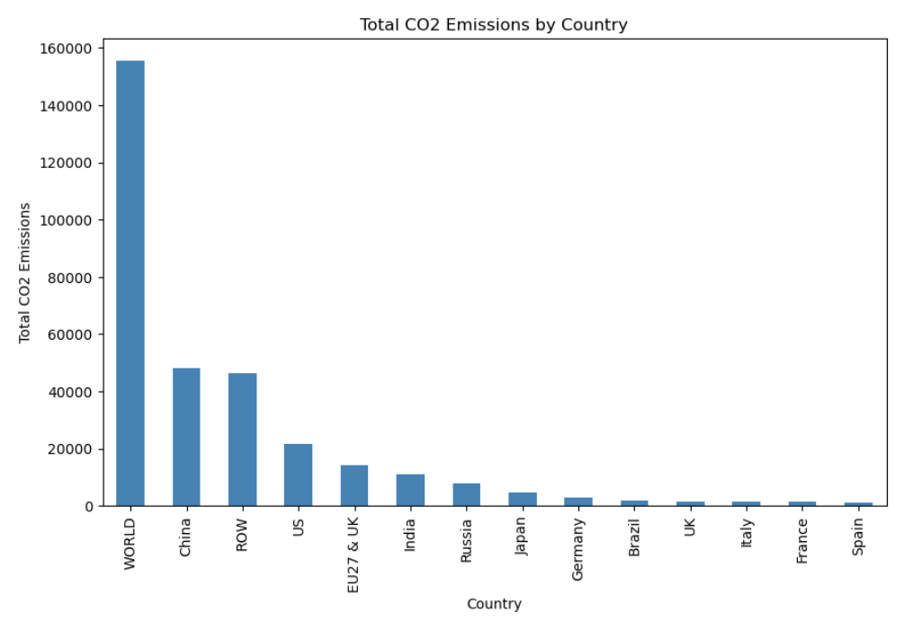
Analysis

Slide 8
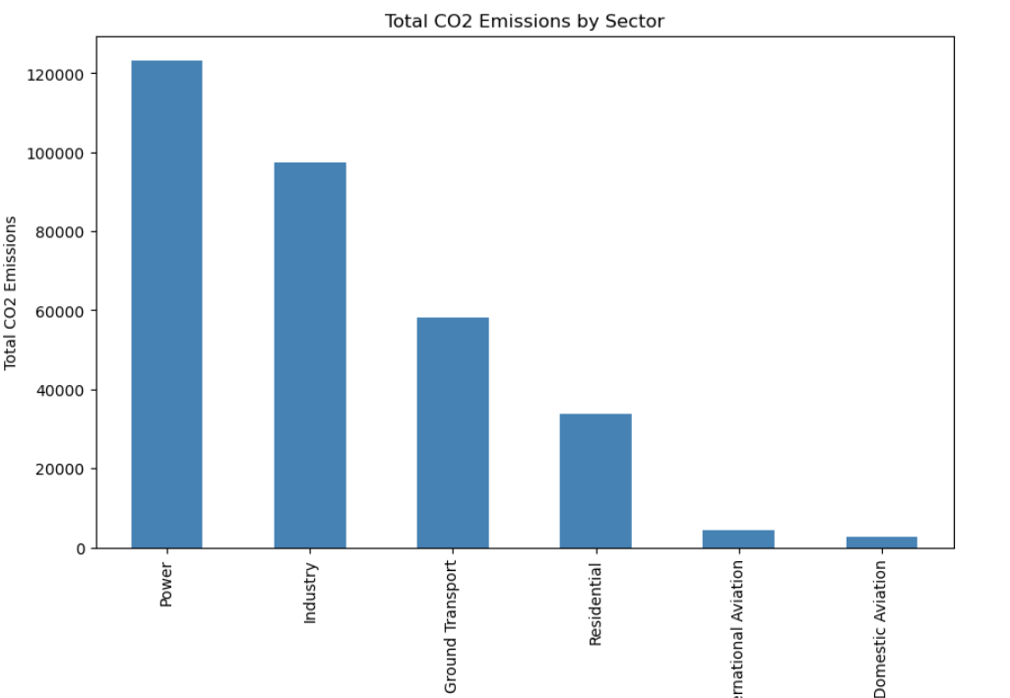
Total emission by sectors

Slide 9
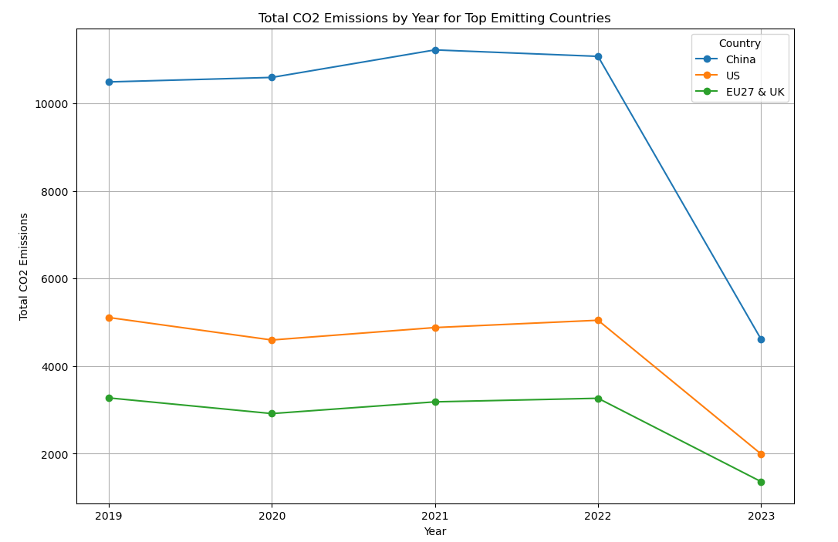
By year and sector for top emitting countries

Slide 10
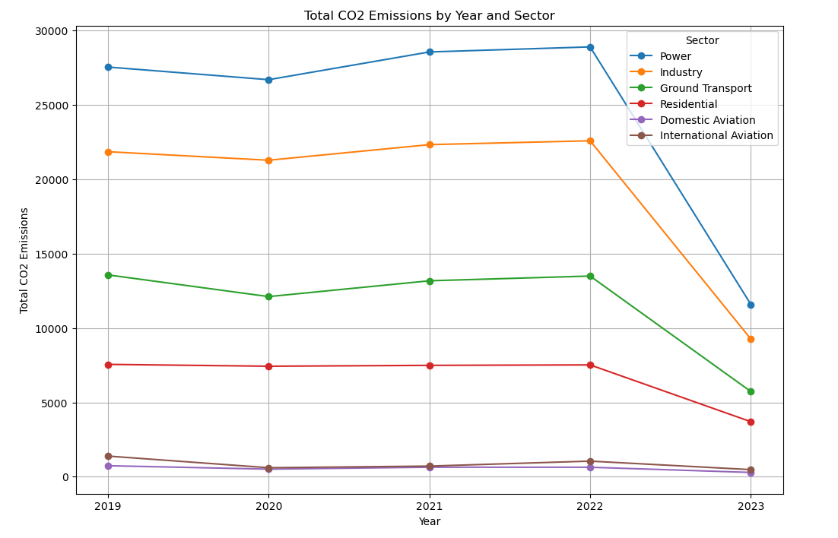
By year and sector
The same analysis is also done for each top emitting country that being CHINA,US and UK

Slide 11
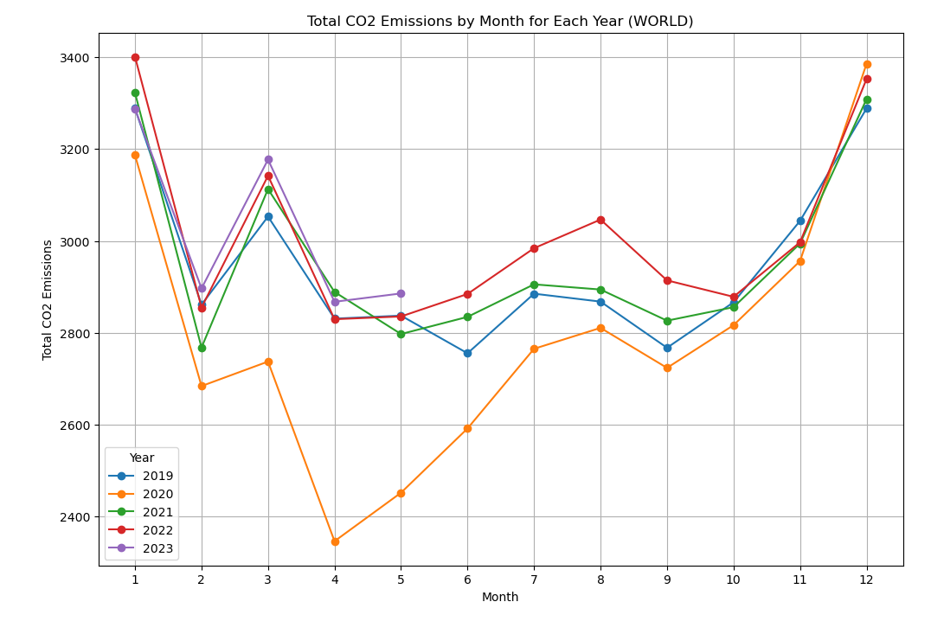
By Month for each year
The same analysis is also done for each top emitting
country

Slide 12
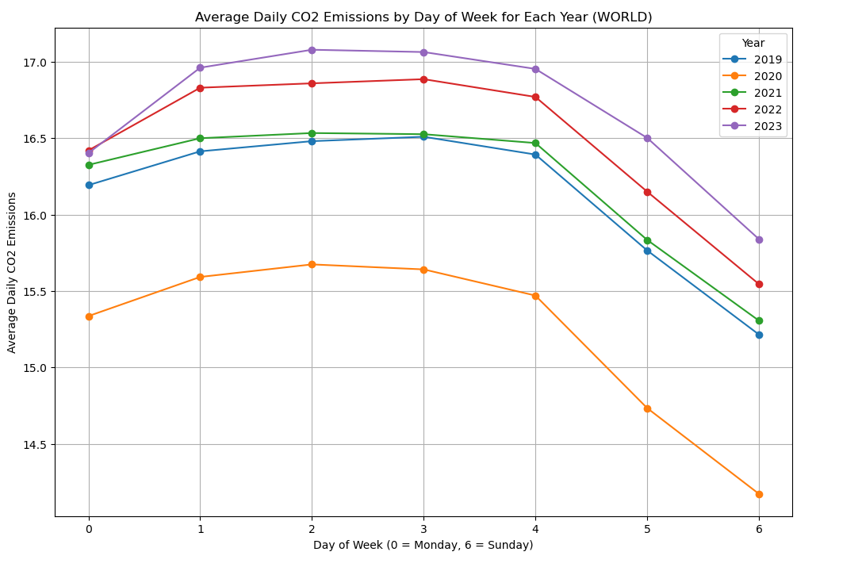
By day of the week
CO2 emissions vary significantly across sectors, with energy production, transportation, and industry being the major contributors, in terms of countries the major contributors are china,us and uk. Addressing emissions requires a multi-faceted approach, including transitioning to clean energy sources, enhancing energy efficiency, and promoting sustainable practices in agriculture and land use. Effective mitigation efforts in these sectors are vital to combat climate change and achieve a more sustainable future.

Slide 13
How does this help and Future scope

